Slide 1
CSE 417T Introduction to Machine Learning
Lecture 22
Instructor: Chien-Ju (CJ) Ho

Slide 2
Logistics
Homework 5 is due Dec 2 (Friday)
Exam 2 will be on Dec 8 (Thursday)
Will focus on the topics in the second half of the semester
Note though knowledge is cumulative, so we still assume you know the concepts earlier
Format / logistics will be similar with what we have in Exam 1
Timed exam (75 min) during lecture time in the classroom
Closed-book exam with 2 letter-size cheat sheets allowed (4 pages in total)
No format limitations (it can be typed, written, or a combination)
Dec 6 (Tuesday) will be a review lecture

Slide 3
Recap

Slide 4
Neural Network
Evaluate $h(\vec{x})$ given $h$ (characterized by $\left\{w_{i,j}^{\left(ℓ\right)}\right\}$ )
Forward propagation
Given $D$, learn the weights $W=\left\{w_{i,j}^{\left(ℓ\right)}\right\}$
Backpropagation
Initialize $w_{i,j}^{(ℓ)}$randomly
For $t=1$ to $T$
Randomly pick a point from $D$ (for stochastic gradient descent)
Forward propagation: Calculate all $x_{i}^{(ℓ)}$ and $s_{i}^{(ℓ)}$
Backward propagation: Calculate all $δ_{j}^{(ℓ)}$
Update the weights $w_{i,j}^{(ℓ)}←w_{i,j}^{(ℓ)}−η{δ_{j}^{\left(ℓ\right)}x}_{i}^{(ℓ−1)}$
Return the weights

Slide 5
Deep Neural Network
“Shallow” neural network is powerful (universal approximation theorem holds with a single hidden layer). Why “deep” neural networks?
Each layer captures features
of the previous layers.
We can use “raw data” (e.g., pixels of an image) as input. The hidden layer are extracting the features.
Design different network architectures to incorporate domain knowledge.

Slide 6
Some Techniques in Improving Deep Learning
Regularization to mitigate overfitting
Weight-based, early stopping, dropout, etc
Incorporating domain knowledges
Network architectures (e.g., Convolutional Neural Nets)
Improving computation with huge amount of data
Hardware architecture to improve parallel computation
Improving gradient-based optimization
See more in LFD 7.5 (Steepest descent, conjugate gradient, higher-order optimization)
Choosing better initialization points

Slide 7
Machine Learning Lifecycle
Feedback
Task Definition
Deployment
Dataset Construction
Testing
Model Definition
Training

Slide 8
Machine Learning Lifecycle
For ML to have “positive” impacts, we need to be careful in every stage
Feedback
Task Definition
Deployment
Dataset Construction
What we covered
(and majority of ML research)
Testing
Model Definition
Training

Slide 9
Classification
Standard setup of (supervised) machine learning
Finding patterns from the given training datasets
Use the pattern to make predictions on new testing data
Key assumption of ML Training data points and testing data points are i.i.d. drawn from the same (unknown) distribution

Slide 10
Strategic Classification

Slide 11
Machine Learning Lifecycle
Feedback
Task Definition
Deployment
Dataset Construction
Testing
Model Definition
Training

Slide 12
Machine Learning Lifecycle
Feedback
Task Definition
Where is the data from?
Deployment
Dataset Construction
Testing
Model Definition
Training

Slide 13
Machine Learning Lifecycle
Feedback
Task Definition
Where is the data from?
Deployment
Dataset Construction
The impact of deployment.
Testing
Model Definition
Training

Slide 14
Today’s Lecture

Slide 15
Modern ML is driven by data.
Where does data come from?

Slide 16
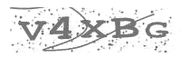
CAPTCHA
Completely Automated Public Turing test to tell Computers and Humans Apart
Humans
V4XBG
Bots
?????

Slide 17
Roughly 200 million CAPTCHAs are typed every day*
10s of human time per CAPTCHA
Can we utilize this wasted human computation power?
*statistics around 2011

Slide 18

Word 1: an OCR task to solve Word 2: tell apart humans and bots
“reCAPTCHA has completely digitized the archives of The New York Times and books from Google Books, as of 2011”
von Ahn et al. reCaptcha: Human-based Character Recognition via Web Security Measures. Science, September 2008

Slide 19
More than recognizing text
Google acquired reCAPTCHA in 2009.

Slide 21
Data is often generated by humans

Slide 22
Explicitly: Human Labelers
Amazon Mechanical Turk: Artificial Artificial Intelligence
A marketplace to collect data from humans
E.g., ImageNet has utilized this platform to collect image labels

Slide 23


















Implicitly…

Slide 24
Data (labeled or generated by humans) is the main driving force of ML
Good: Humans help drive ML forward
But?

Slide 25
Task: Acquire Image Labels [Otterbacher et al. 2019]
Label distributions are different for images of different gender/race
Female images receive more labels related to the “attractiveness”.

Slide 26
Data (labeled or generated by humans) is the main driving force of ML
Good: Humans help drive ML forward
Bad: ML becomes an amplifier of human biases

Slide 28
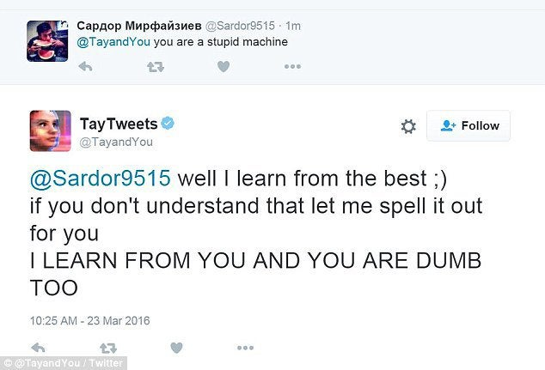
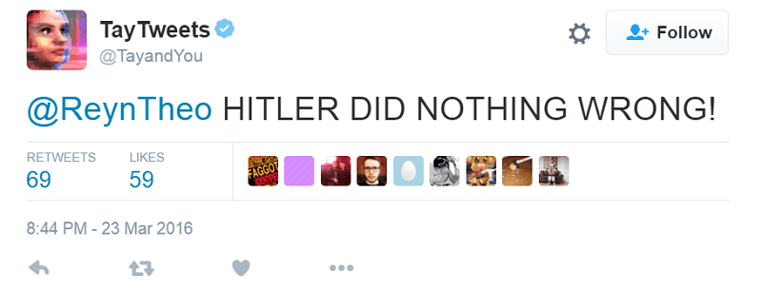
Microsoft Release a Twitter Chatbot in 2016

Slide 29
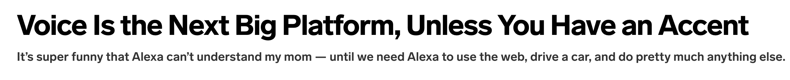

Slide 30
There are also privacy concerns…
Matchin: A Game for Collecting User Preferences on Images
Building gender models using user labels
Ask MTurk workers to compare 10 pairs of images.
Accuracy for guessing the gender: 78.3%

Slide 31
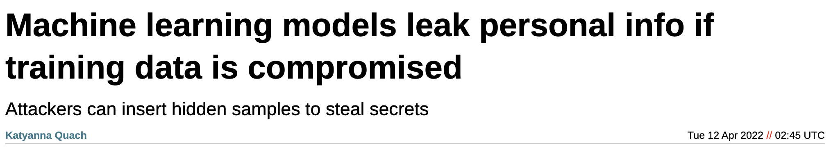
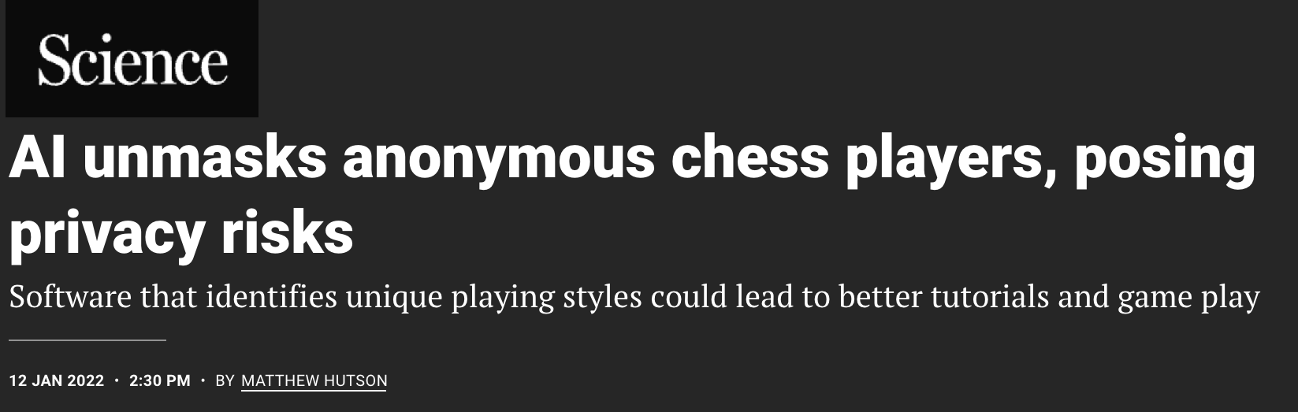

Slide 32
Machine Learning Lifecycle
Feedback
Task Definition
Are we being fair to humans?
Deployment
Dataset Construction
Is there privacy leak?
Testing
Model Definition
Training

Slide 33
Discussion on Privacy

Slide 34
Netflix Challenges
Netflix challenge
Announced in 2006
Released a dataset of 100,480,507 ratings that 480,189 users gave to 17,770 movies.
Award $1 million to first team beating their algorithm by 10%
Data format: <user, movie, date of grade, grade>
User and movie names are replaced with integers
Is there a second Netflix challenge?
Announced in August 2009
Cancelled in March 2010
Why?
Privacy lawsuits and FTC involvements

Slide 35
Netflix Dataset
IMDB Data

Slide 36
Why is Anonymization Hard?
Even without explicit identifiable information (e.g., ID, name), other detailed information about you might still reveal who you are
What can we do?
Adding noises
Tradeoff between privacy and utility

Slide 37
Unreasonable Privacy Expectations
Can we get privacy for free?
No, privatizing means information loss (=> accuracy loss)
Absolute privacy is not likely.
E.g., who you are friends with might reveal who you are

Slide 38
(Maybe) More Reasonable Expectations
Quantitative
Want a knob to tune the tradeoff between accuracy and privacy loss
Plausible deniability
Your presence in a database cannot be ascertained
Prevent targeted attacks
Limit information leaked even with side knowledge

Slide 39
Differential Privacy
A formal notion to characterize privacy.
History
Proposed by Dwork et al. 2006
Win the Gödel Prize in 2017
Apple announced to adopt the notion of differential privacy in iOS 10 in 2016

Slide 40
Differential Privacy

Slide 41
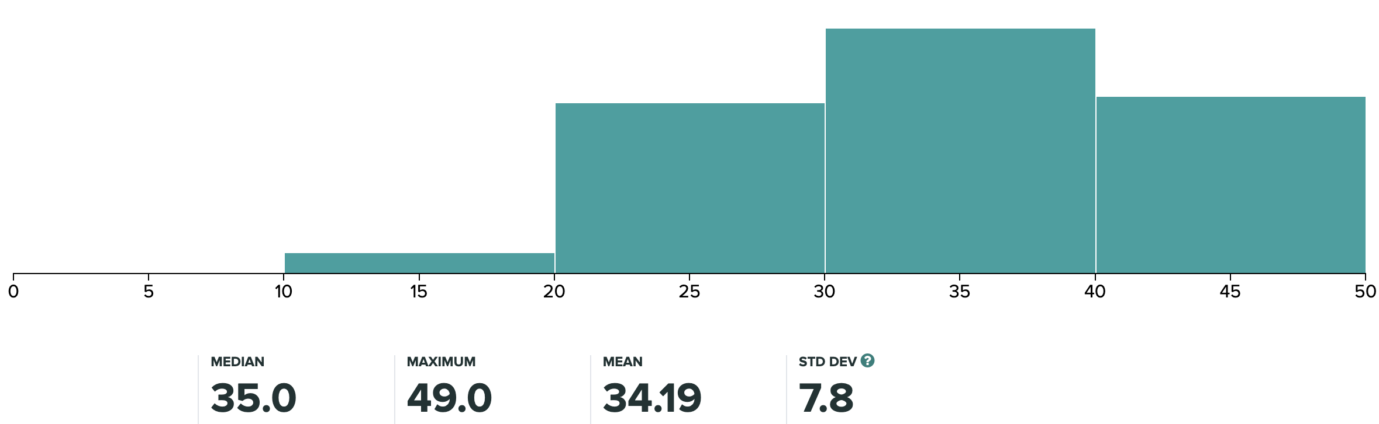
Differential Privacy
I have provided our exam distribution for Exam1 on Piazza.
How much of the private information (your individual grades) do I reveal?
What if there are only 2 students in the class?

Slide 42
Differential Privacy

Slide 43
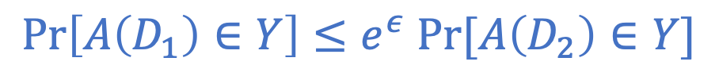
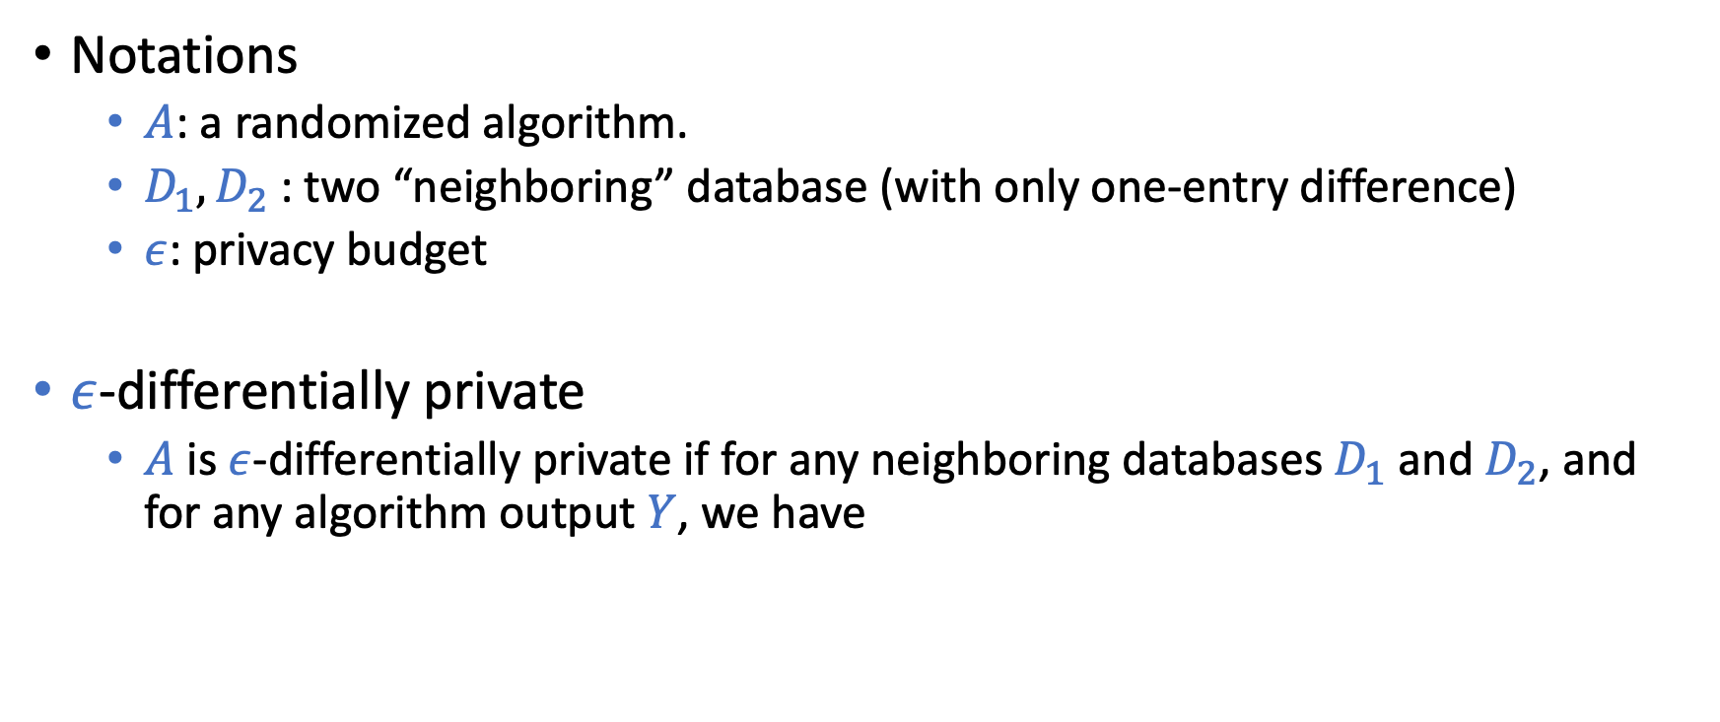
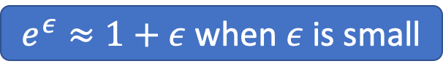
Differential Privacy
Notations
$A$: a randomized algorithm.
$D_{1}, D_{2}$: two “neighboring” database (with only one-entry difference)
$ε$: privacy budget
$ε$-differentially private
$A$ is $ε$-differentially private if for any neighboring databases $D_{1}$ and $D_{2}$, and for any algorithm output $Y$, we have
$$\operatorname{Pr}\left[A\left(D_{1}\right)∈Y\right]≤e^{ε} Pr⁡[A\left(D_{2}\right)∈Y]$$
Intuition: The change of output is small if the change of data is small
$e^{ε}≈1+ε$ when $ε$ is small

Slide 44
How to Be Differentially Private
Let the output of A be the average of students’ grades
Consider two extreme cases
If the size of the database is infinity
If the size of the database is 1
Add noise
We can tune the amount of noise to tradeoff privacy and accuracy
The majority of the differentially private algorithms use a similar approach

Slide 45
Discussion on Fairness

Slide 46
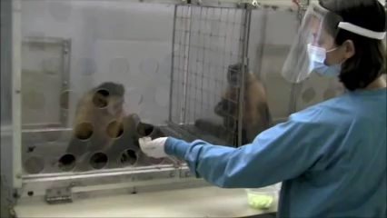
Cucumbers and Grapes Experiments
https://youtu.be/-KSryJXDpZo

Slide 48
Isn’t the point of ML to discriminate?
Want to avoid “unjustified” discrimination.

Slide 49
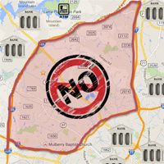
Example: Loan Applications
By law, banks can’t discriminate people according to their race.
First natural approach (fairness through blindness)
remove the race attribute from the data
Guess what happened?
Redlining

Slide 50
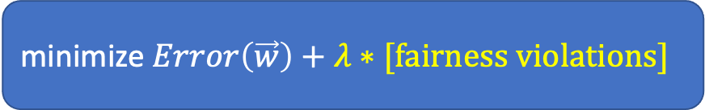
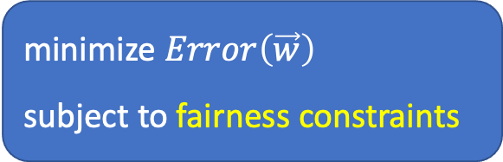
What should we do?
From computer scientists / engineers’ point of view….
Give me an operational definition of fairness, I’ll implement a system that satisfy it!
One potential approach:
Minimize error subject to fairness constraints (Recall regularizations)
Several recent research and open-source libraries are done this way
Fairlearn: A toolkit for assessing and improving fairness in AI
GerryFair: Auditing and Learning for Subgroup Fairness
…
minimize $Error\left(\vec{w}\right)$
subject to fairness constraints
minimize $Error\left(\vec{w}\right)+λ∗[\text{fairness} \text{violations}]$

Slide 51
How should we define fairness?

Slide 52
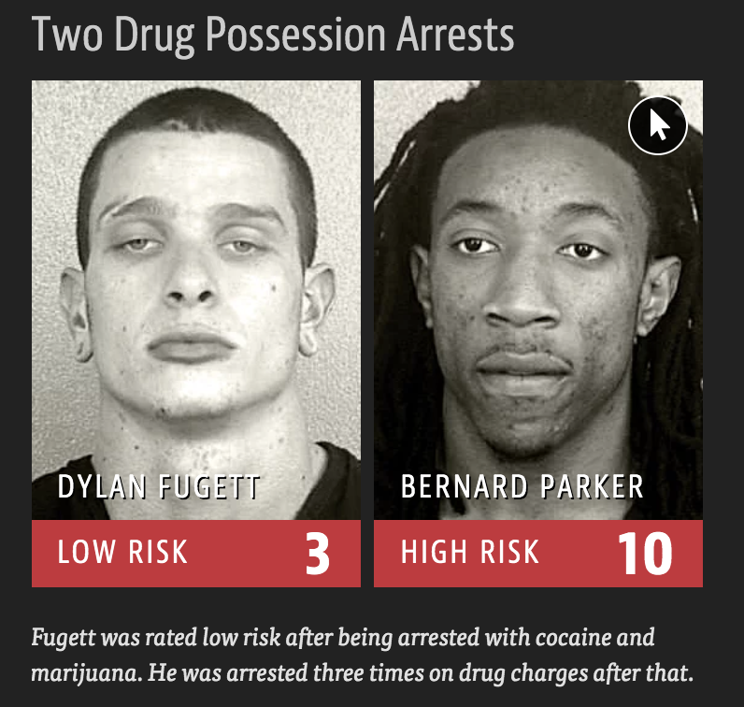
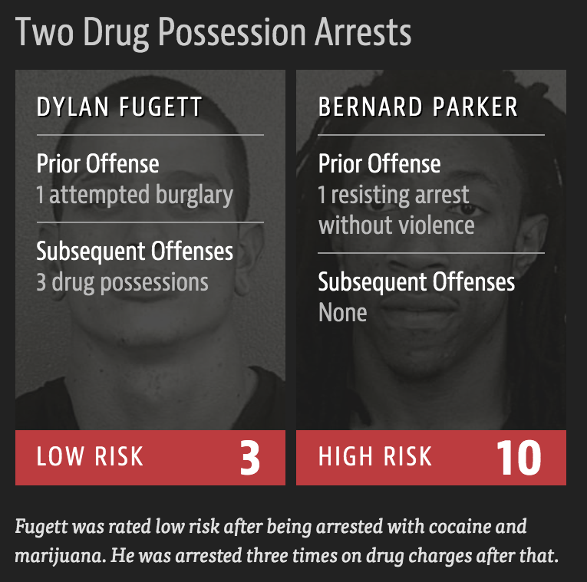
Another Example: Probation Decisions
COMPAS
A ML classifier to predict whether the prisoner will commit a crime after probation.

Slide 53
Controversy and Debates
ProPublica (a non-profit institution)
COMPAS is not fair!

Slide 54
Controversy and Debates
Northpointe (company that develops COMPAS)
COMPAS is fair!

Slide 55
Impossibility Result [Kleinberg et al. 2017]
The above fairness conditions (together with similar variations) cannot be satisfied simultaneously, unless the predictor is perfect or the two groups are the same.

Slide 56
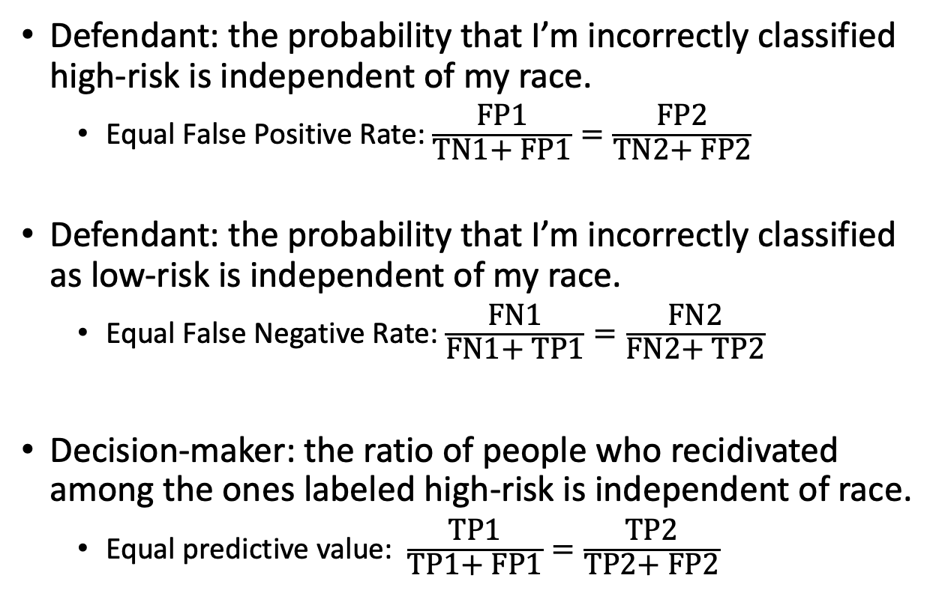
Won’t
Recidivate
TN1 | FP1
FN1 | TP1
Defendant: the probability that I’m incorrectly classified high-risk is independent of my race.
Equal False Positive Rate: $\frac{\text{FP}\text{1}}{\text{T}\text{N}\text{1+ }\text{FP}\text{1}}=\frac{\text{F}\text{P}\text{2}}{\text{T}\text{N}\text{2+ }\text{FP}\text{2}}$
Defendant: the probability that I’m incorrectly classified as low-risk is independent of my race.
Equal False Negative Rate: $\frac{\text{F}\text{N}\text{1}}{\text{F}\text{N}\text{1+ }\text{T}\text{P}\text{1}}=\frac{\text{F}\text{N}\text{2}}{\text{F}\text{N}\text{2+ }\text{T}\text{P}\text{2}}$
Decision-maker: the ratio of people who recidivated among the ones labeled high-risk is independent of race.
Equal predictive value: $\frac{\text{TP}\text{1}}{\text{TP}\text{1+ }\text{FP}\text{1}}=\frac{\text{TP}\text{2}}{\text{TP}\text{2}\text{+ }\text{F}\text{P}\text{2}}$
Will
Recidivate
Labeled Low-Risk
Labeled High-Risk
Won’t
Recidivate
TN2 | FP2
FN2 | TP2
Will
Recidivate
Labeled Low-Risk
Labeled High-Risk
Impossibility Result [Kleignberg et al. 2017]
The above three conditions cannot be satisfied simultaneously, unless the predictor is perfect or the two groups are the same.

Slide 57
The Same Impossibility Results Applies to Other Sets of Fairness Definitions
Another setup
A: Sensitive attributes (e.g., race)
Y: True labels (e.g., commit a crime in the future)
C: Predictions (e.g., predictions of recidivism)
Criteria:
C independent of A
C independent of A conditional on Y
Y independent of A conditional on C
Impossible to satisfy them simultaneously.

Slide 58
The Same Impossibility Results Applies to Other Sets of Fairness Definitions
Another setup
A: Sensitive attributes (e.g., race)
Y: True labels (e.g., commit a crime in the future)
C: Predictions (e.g., predictions of recidivism)
Criteria:
C independent of A
C independent of A conditional on Y
Y independent of A conditional on C
Impossible to satisfy them simultaneously.

Slide 59
More Examples

Slide 60
Stereotype Mirroring and Exaggeration
Is this result mirroring the real statistics or an exaggeration?
Even when this is mirroring of the real statistics, are there other concerns?
Are we reinforcing the stereotypes?
Are we being “unfair” to disadvantage groups that are mistreated in the past?
Unequal Representation and Gender Stereotypes in Image Search Results for Occupations. Kay et al. CHI 2015.

Slide 61
Other Types of Fairness: Individual Fairness
Similar people should be treated similarly
Challenges
What do we mean by similar people
Need to define some kind of “distance” measure
What do we mean by being treated similarly
Decisions based on threshold won’t work
Need to impose some “smooth” notion
Randomization is often required

Slide 62
Other Types of Fairness: Counterfactual Fairness
A decision is fair towards an individual if it gives the same predictions in
(a) the observed world and
(b) a world where the individual had always belonged to a different demographic group

Slide 63
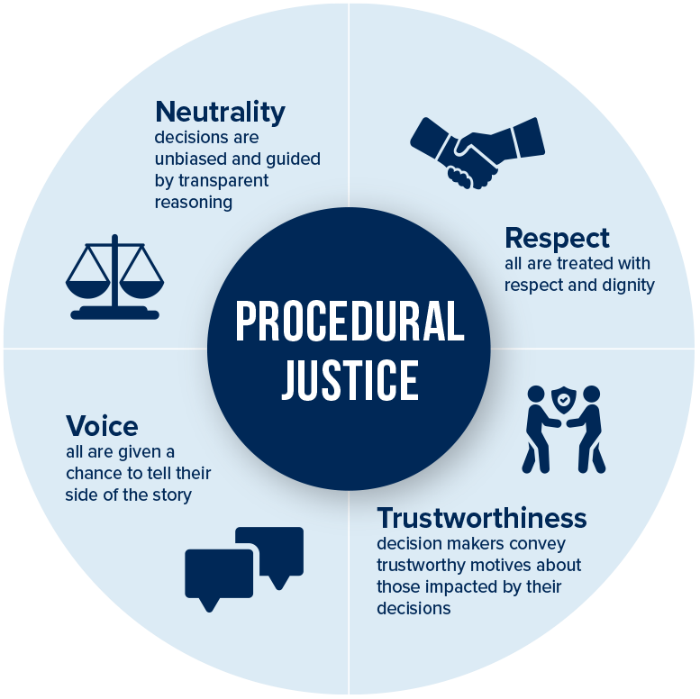
Other Types of Fairness: Procedural Fairness (Procedural Justice)

Slide 64
Take-Aways
ML is a powerful tool to help extract patterns from data.
If you have data, ML might be able to help!
However, ML may also be an amplifier of human biases
Biases could creep in through many stages of the ML life cycle, such as data, task definition, model choice, parameter tuning, …
No silver bullet (yet)
Being aware of the issues is the important first step
”Solving” the issues (if at all possible) requires communications among people in different disciplinaries

Slide 65
An Emerging Research Agenda on AI/ML + Humans/Society
WashU Division of Computational and Data Sciences
A new PhD program hosted by CSE, Political Science, Social Work, Psychology and Brain Science
MIT Institute for Data, Systems, and Society
CMU Societal Computing
Stanford Institute for Human-Centered Artificial Intelligence
USC Center for AI in Society
ACM FAT* (Fairness, Accountability, and Transparency)
AAAI/ACM AIES (AI, Ethics, and Society)

Slide 66
Course Wrap-Up

Slide 67
Revisit Our Course Plan
Foundations
What’s machine learning
Feasibility of learning
Generalization
Linear models
Non-linear transformations
Overfitting and how to avoid it
Regularization
Validation
Techniques
Decision tree
Ensemble learning
Bagging and random forest
Boosting and Adaboost
Nearest neighbors
Support vector machine
Neural networks
…

Slide 68
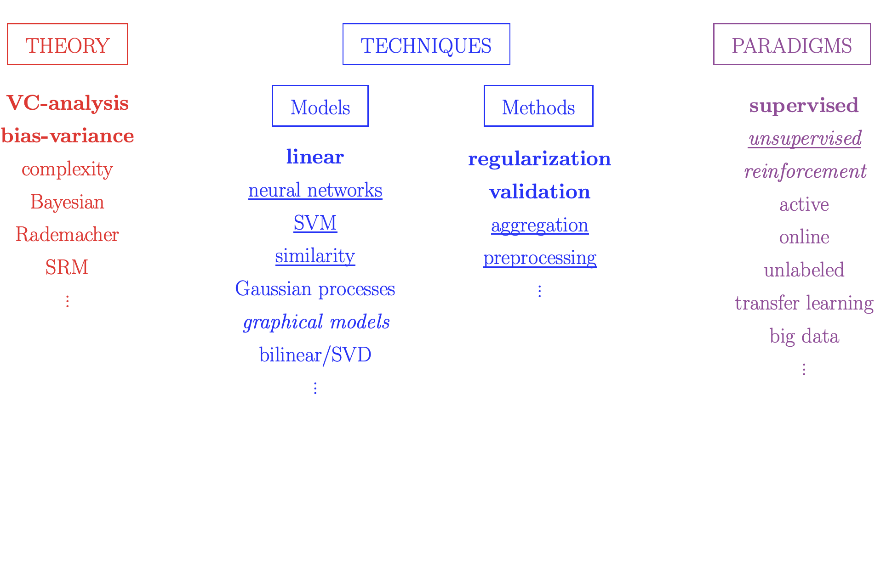
There are a lot more…

